Slide 1
SCS3212 Machine Learning Algorithms & Programming
Part 4 Classification
Peter Waiganjo Wagacha, 2026

Slide 2
Machine Learning: A paradigm shift

Slide 3
Code
Paradigm shift
Data
Answers
Rules
Data
Rules
Answers
Data
Rules
C
L
A
S
S
I
C
M
L

Slide 4
Model
Paradigm shift
Data
Answers
Rules
Data
Predictions
Labels
= targets
Data
Predictions
C
L
A
S
S
I
C
M
L

Slide 5
Model
Paradigm shift
Data
Answers
Rules
Data
Predictions
Labels
= targets
Data
Predictions
C
L
A
S
S
I
C
Rule-based
Data-driven
M
L
Goal is to predict

Slide 6
Types of Learning (Learning Paradigms)
Machine Learning
Supervised
Learning
Unsupervised Learning
Reinforcement Learning
Supervised learning - is when the model is getting trained on a labelled dataset. Labelled dataset is one which have both input and output data vectors. This is synonymous with learning with a teacher.
Unsupervised learning - is when the model is getting trained using an un-labelled dataset. The dataset here only has input data vector. This is synonymous with learning with no teacher
Reinforcement Learning – is when the model uses rewards in the training process. This is synonymous with learning with a teacher who gives rewards and penalties.

Slide 7
Types of Learning
Machine Learning
Supervised
Learning
Unsupervised Learning
Reinforcement Learning
Classification
,…
Clustering
Regression
,…
Assoc. Analysis
,…
Q Learning

Slide 8
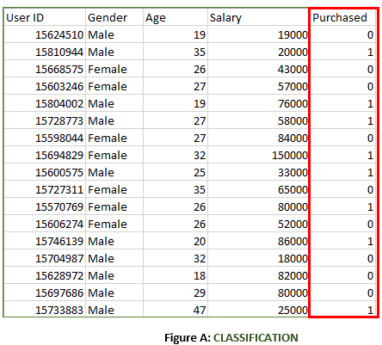
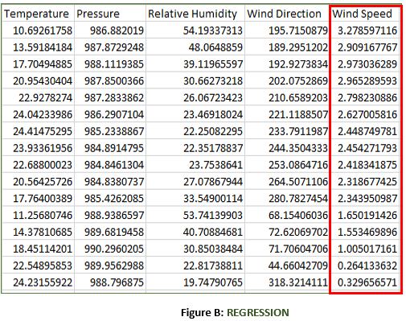
Classification and Regression

Slide 9
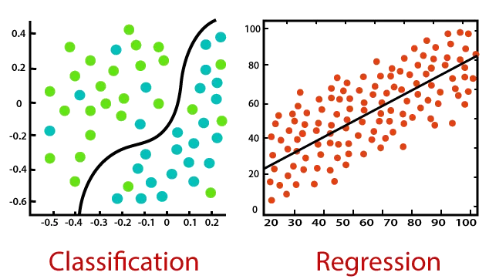
Classification and Regression
Source: https://artofbetterprogramming.com/2020/06/21/supervised-machine-learning-algorithms-topics-of-machine-learning/

Slide 10
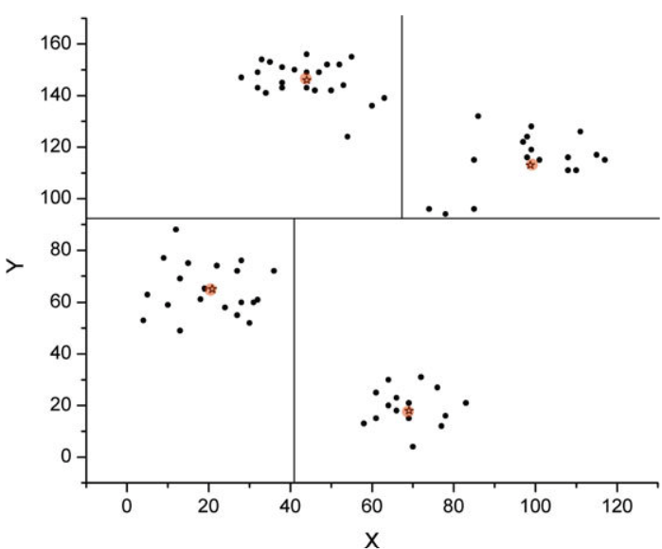
Classification
Illustration of a simple four-class classification model for a two-dimensional data set (filled circles denote the samples, whereas stars denote the centre of each class). Note the decision boundaries – they are not necessarily parallel to the coordinate axes; they can be oblique or even curvilinear
Source: Clara Curiel-Lewandrowski, et.al. Artificial Intelligence Approach in Melanoma

Slide 11
What is a classification problem?
In a classification problem, you are given the data and for each data point a label. The data is commonly called labeled data. Also referred to as “Labeled by a teacher”
The task is to create a model from the labeled data so that the model can predict a label for any new data point for which the label is unknown.
Source: https://computing4all.com/courses/introductory-data-science/lessons/what-is-a-classification-problem/

Slide 12
For example, the following table contains (fictitious) data regarding coronavirus infection. Each row reflects information of a patient.
Average temp. | Oxygen processing (%) | Congestion (%) | Cough (per hour) | Factor in blood | Coronavirus
38.9 | 70 | 50 | 30 | 5 | Infected
36.7 | 85 | 80 | 10 | 3 | Infected
36.1 | 99 | 10 | 1 | 1 | Not infected
37.8 | 82 | 60 | 15 | 2.5 | Infected
36.1 | 85 | 30 | 30 | 2 | Not infected
37.2 | 90 | 10 | 20 | 2 | Infected

Slide 13
Training dataset
Training data is the data that is used to build the classification model. A training dataset contains a column with class labels.
For example, the labeled data can be used as the training data do build a classification model.
Test data
Test data is the data that we hide the column for class labels but with all the other columns like the training data.
That is, test data will be used by the model to predict/classify the test examples/instance, then we compare with the actual (hidden) class labels.

Slide 14
The data below can be used to predict classes using the classification model built using the first table. That means, a classifier that uses a classification model built from the first table (training data) can classify each row of the second table (query data) to either Infected or Not infected.
Average temp. | Oxygen processing (%) | Congestion (%) | Cough (per hour) | Factor in blood | Coronavirus
38.3 | 83 | 62 | 17 | 2.6 | ?
36.6 | 84 | 31 | 32 | 2.1 | ?
37.2 | 88 | 81 | 11 | 4 | ?
36.1 | 91 | 11 | 21 | 2 | ?

Slide 15
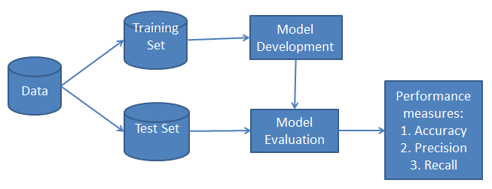
Classification Model – Train and Test
Note: The Training and Test Sets should have similar representation to that of the original dataset. We can also have a validation set for parameter tuning

Slide 16
Performance measures
There are many performance measures depending on the task.
A shortlist:
Classification Accuracy
Logarithmic Loss
Confusion Matrix
Area under Curve (ROC curve)
F1 Score
Mean Absolute Error
Mean Squared Error
..

Slide 17

Performance measures
Classification Accuracy
Works well if there are equal number of samples belonging to each class.
For example, consider that there are 98% samples of class A and 2% samples of class B in our training set. Our model can easily get 98% training accuracy by simply predicting every training sample belongs to class A.
When the same model is tested on a test set with 60% samples of class A and 40% samples of class B, then the test accuracy would drop down to 60%.
Classification Accuracy is convenient, but can give a false sense of achieving high accuracy.
Source: https://towardsdatascience.com/metrics-to-evaluate-your-machine-learning-algorithm-f10ba6e38234

Slide 18
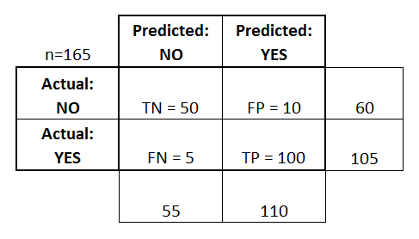
Performance Measures
Confusion Matrix - Presents a matrix as output and describes the complete performance of the model.
Example – Our ML model testing on 165 samples with Class YES and NO gives this result:
True Positives : The cases in which we predicted YES and the actual output was also YES.
True Negatives : The cases in which we predicted NO and the actual output was NO.
False Positives : The cases in which we predicted YES but the actual output was NO.
False Negatives : The cases in which we predicted NO but the actual output was YES.

Slide 19
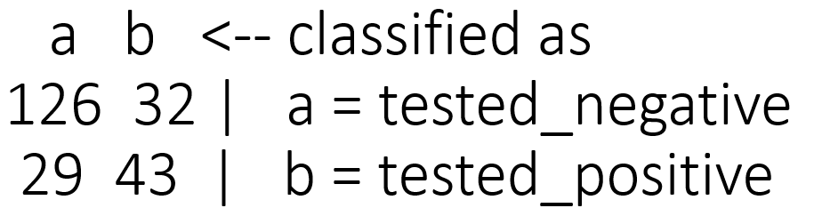
Performance Measures
Sample Confusion Matrix – Diabetes patient data - tests classification.
TN=126; FN=32
FP=29; TP=43

Slide 20
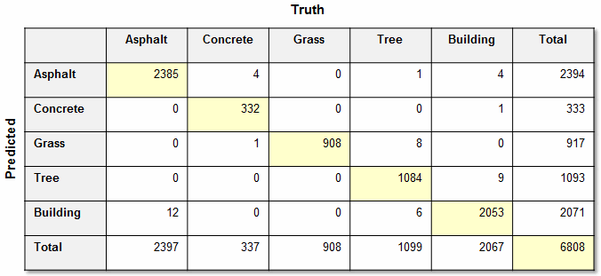
Performance Measures
Sample Confusion Matrix - Drone image classification for 5 classes
Q. What is the classification accuracy?

Slide 21
Creating classification models
The creation of a classification model involves the following stages:
1. Data preparation (importing, processing, exploration and statistical analysis) This stage divides the data into two or three parts:
training data – will be used to build the model
validation data (in more complex cases) – will be used for evaluation of model quality during its creation
testing data – will be used to establish the final quality of the model
2. Model creation (using training and optionally validation)
3. Model quality assessment (testing the created model on testing data)
4. Model application and subsequent monitoring (periodical checks if the quality of predictions does not deteriorate over time, for instance due to demographic or market changes)
Source: https://algolytics.com/tutorial-how-to-determine-the-quality-and-correctness-of-classification-models-part-1-introduction/

Slide 22
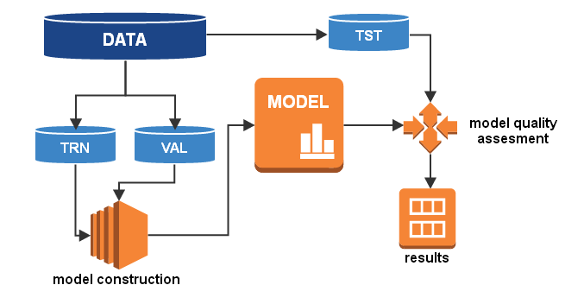
Creating classification models
Data is split into three sets: Training, Validation and Testing sets.
Model is based on Training and Validation datasets. Test set is used to assess the model quality or algorithm-model performance.

